Slide 1

Notes:
So before i start, can i ask all of you to scan this QR code as the UI will take awhile to load.

Slide 2
Cardiovascular Disease
Cardiovascular Disease Public Awareness
Notes:
Our group today will be sharing about cardiovascular disease (CVD) and the dataset we have used.
CVD is a build-up of fatty deposits inside the arteries which affects the heart and blood vessels.
seb

Slide 3

Contributions of Team Members
Germaine Chong (U2021919F)
Development of User Interface (UI)
Integration of Machine Learning and UI
Luqman Hakeem (U2022830A)
Exploratory Analysis / Data Visualisation
Cleaning of Dataset
Sebastian Chong Kok Leong (U2022926A)
Development of User Interface (UI)
Cleaning of Dataset
Lee Wei Ming (U2022064E)
Classification Tree
Overall Checking of Codes
Notes:
Hi, this is everyone

Slide 4


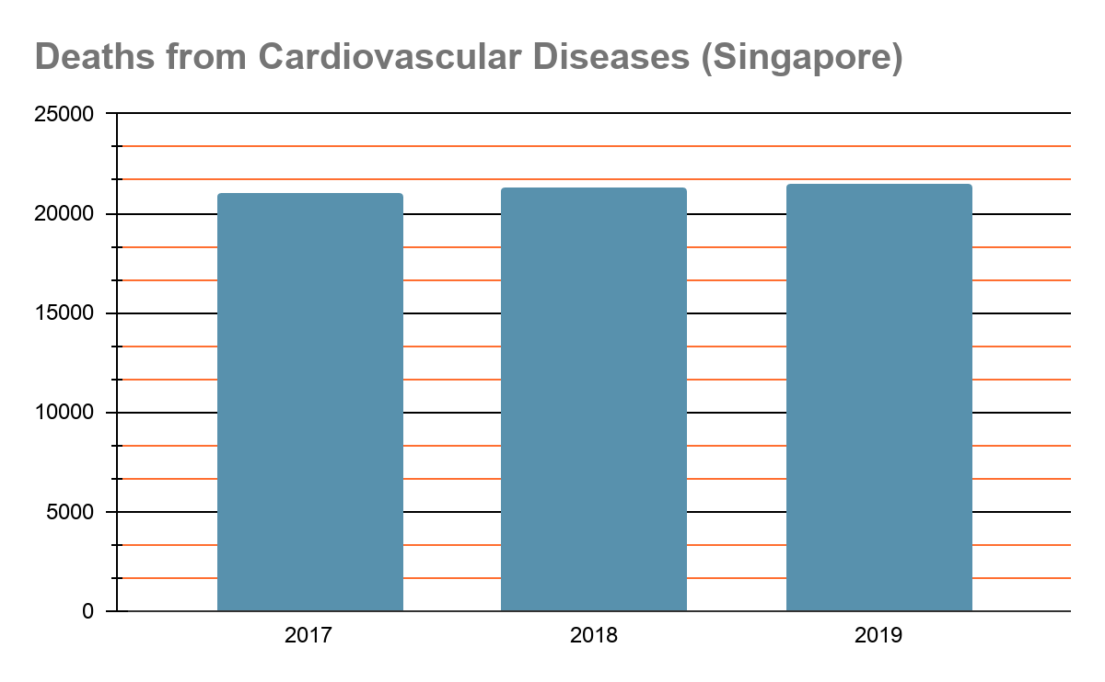
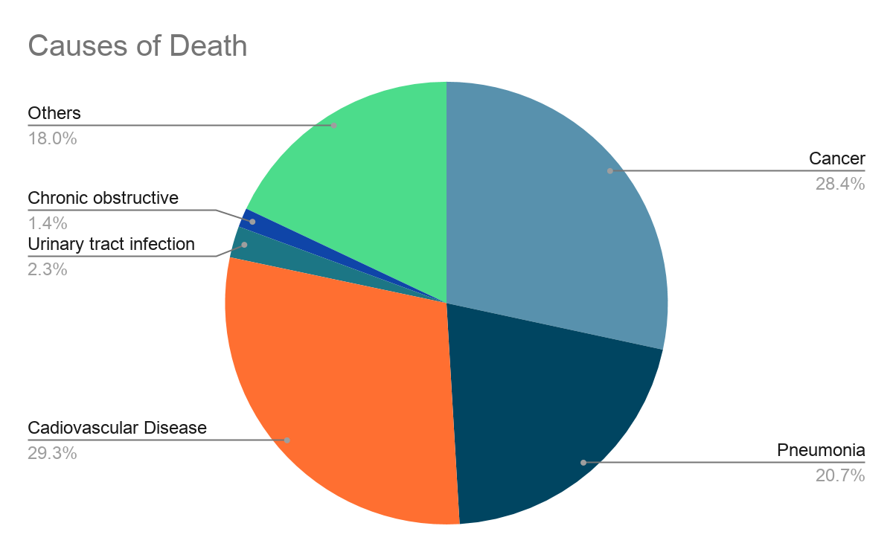
Statistics Garnered
Source : Singapore Heart Foundation
29.3% of deaths from Cardiovascular Diseases
Notes:
There is an increasing trend of CVD death in Singapore
Also, at the orange sector side the total death from CVD alone is ⅓ of the total causes of death.

Slide 5
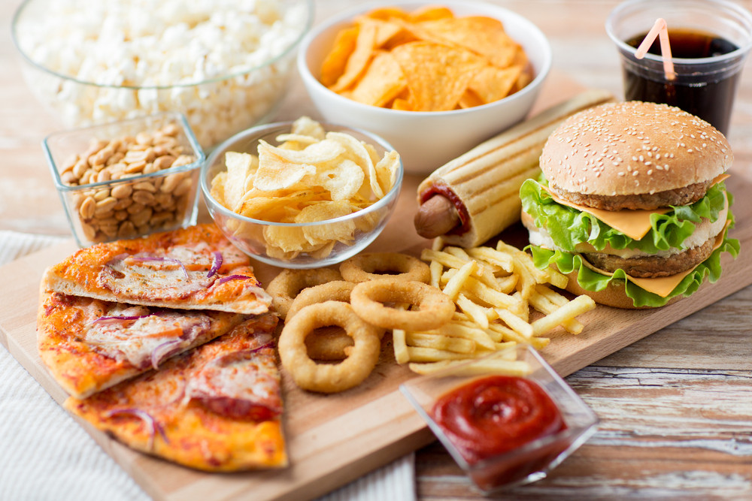
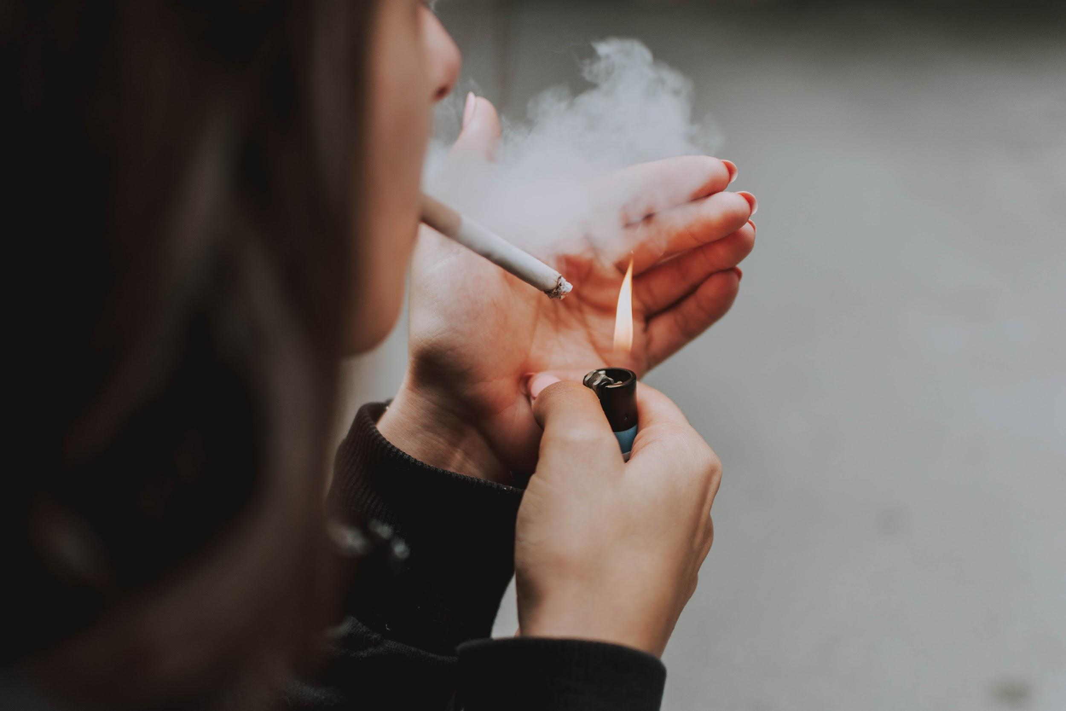
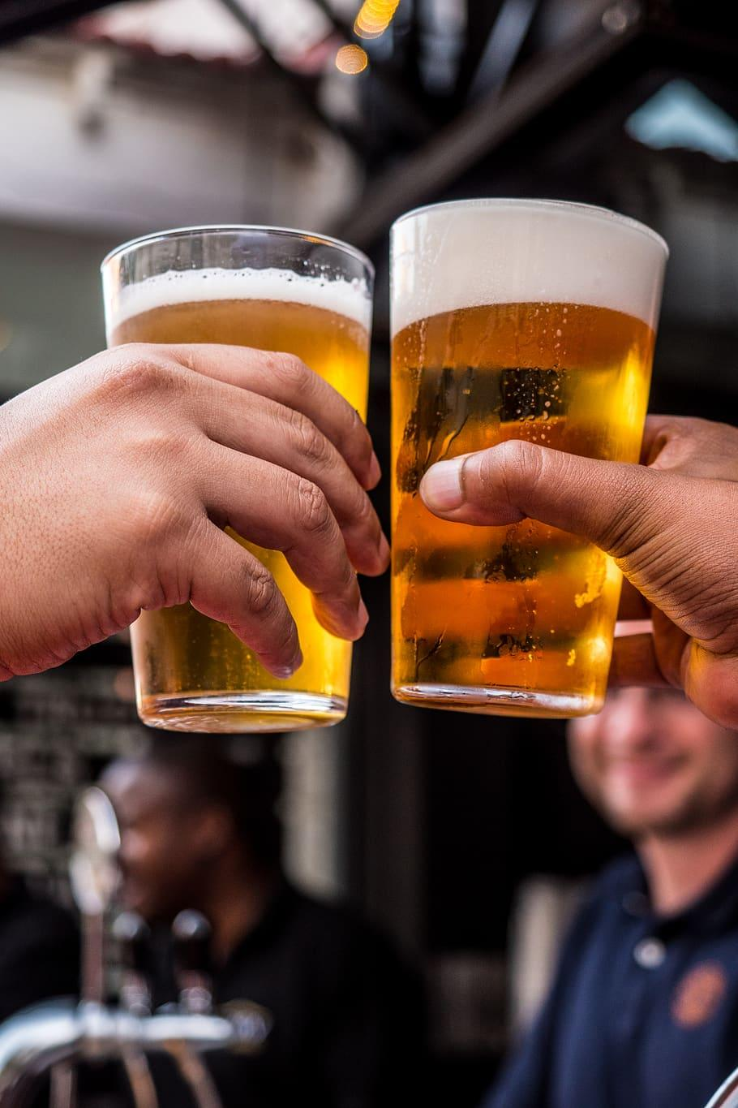
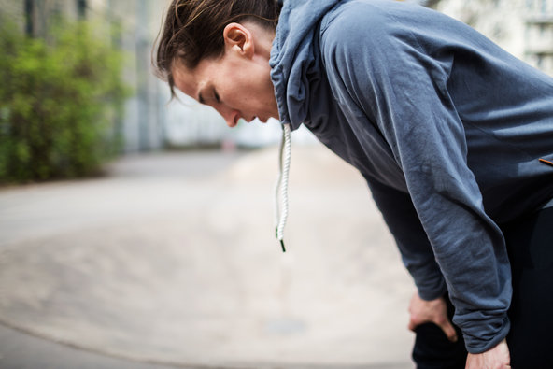
Leading Causes of Cardiovascular Diseases
Smoking Addiction
Unhealthy Diet
Cardiovascular Diseases
Lack of Exercise
Frequent Alcohol Consumption
Notes:
No smoking. No raydy.

Slide 6
Objective of Our Project
Raise awareness on the risk of Cardiovascular (CVD)
To inform the public on the prevention on CVD
Calculate the user’s risk of developing CVD

Slide 7

Dataset Cleaning

Slide 8
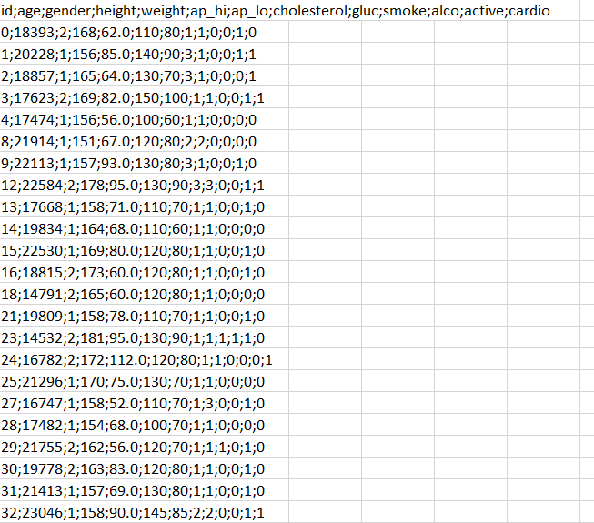
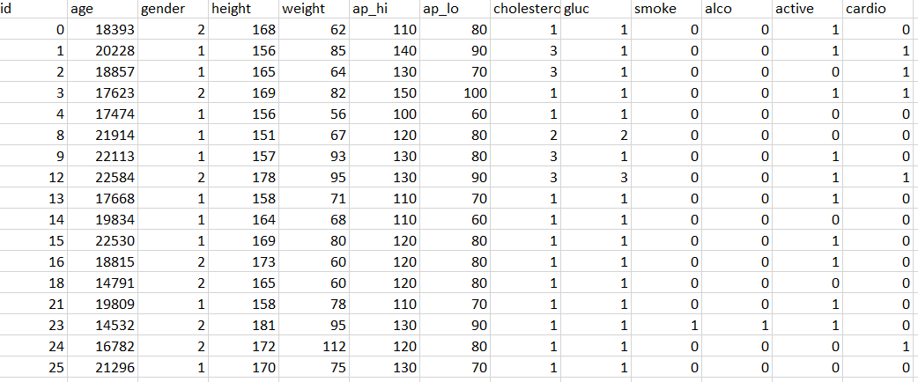
Dataset Cleaning (Excel)
After formatting
Before formatting
Notes:
Before: Dataset is messy and all the numbers are in the same column.
After: We delimit the dataset through excel and reorganise them in their individual column.

Slide 9
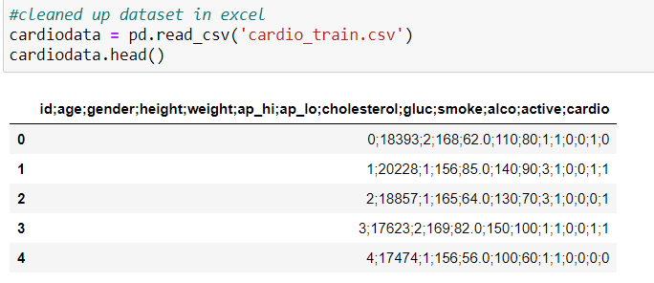
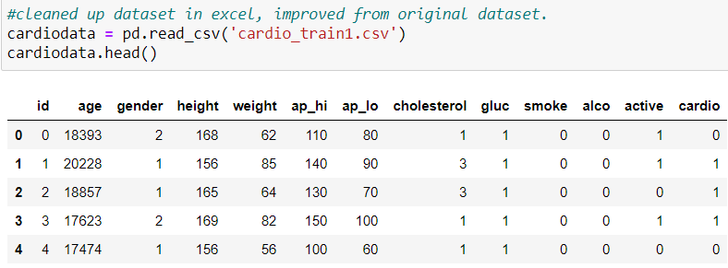
Dataset Cleaning (Jupyter Notebook)
Before formatting
After formatting
Notes:
The slide above shows when we tried to import a raw dataset and a cleaned dataset. With a cleaned dataset we can then move on to do our analysis.

Slide 10
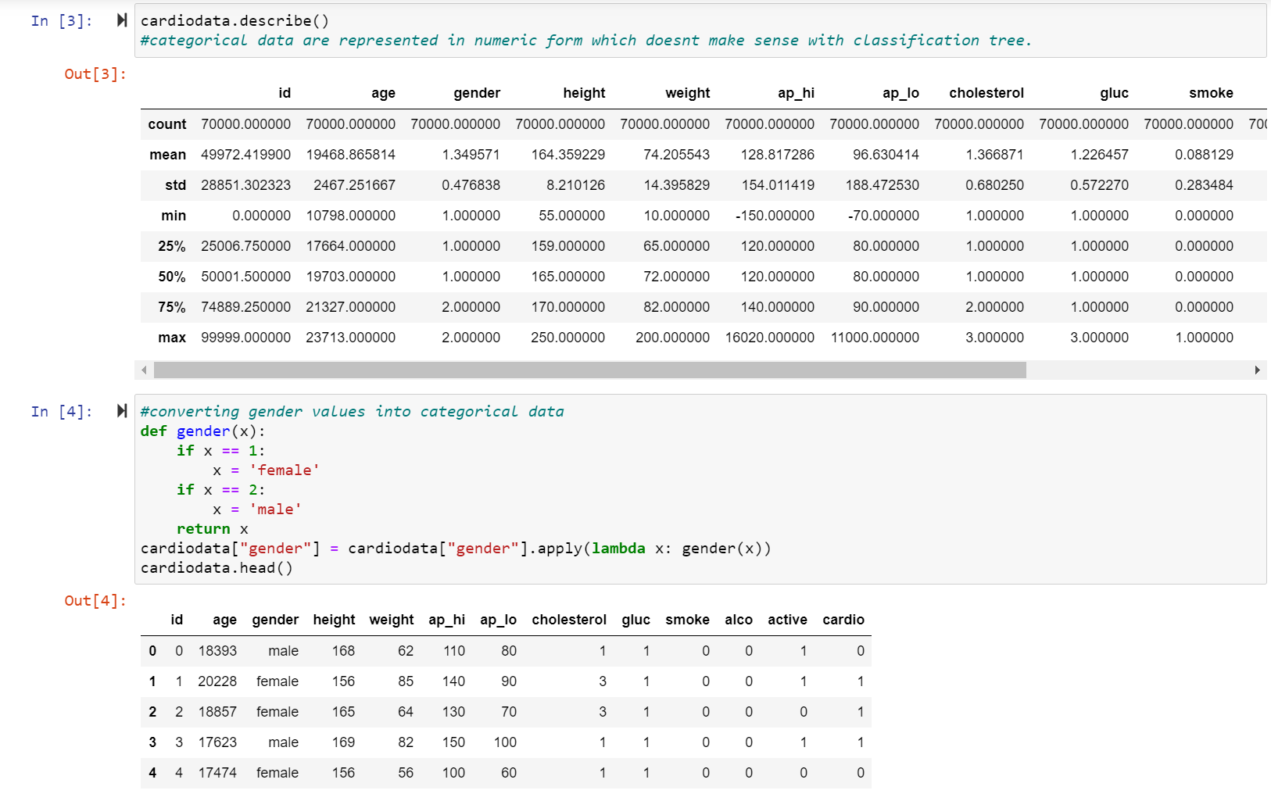
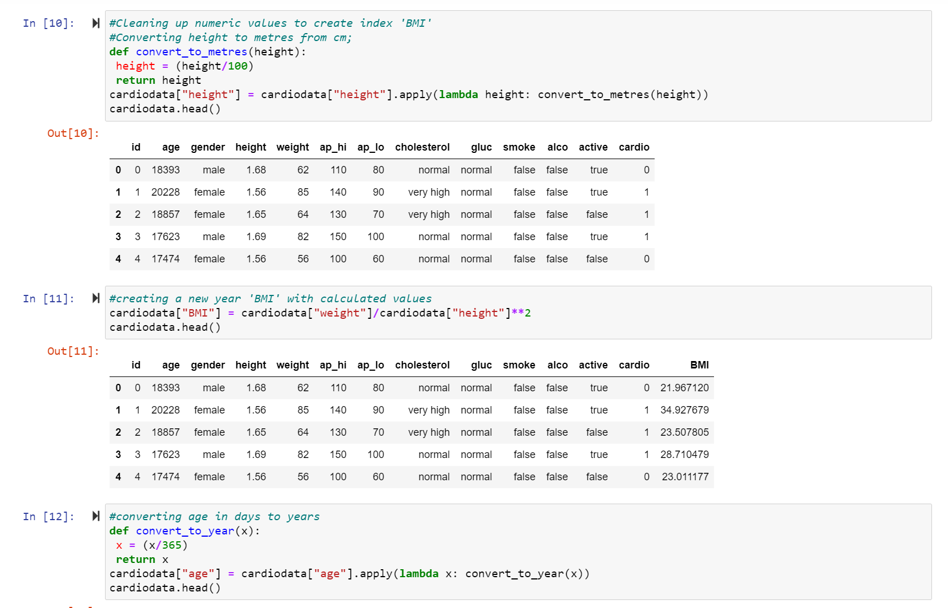
Dataset Cleaning (Coding)
Categorical datas are stored as binary data.
Numerical data are not stored in usual formats.
Created new index column for data visualization (BMI)
Notes:
From the dataset, genders are given as number. 1 for female and 2 for male. We went on to convert those numbers so we can identity female and male easily.
We also created a new column called ‘BMI” using the formula as weight/ heightˆ2 as BMI is needed to calculate the risk of getting CVD.
BMI = (Weight)/(Height)^2
seb

Slide 11

Exploratory Analysis
Notes:
keem

Slide 12
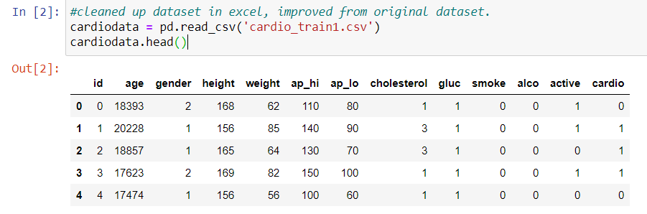
Statistical Summary of Dataset
Notes:
Too many var
Remove choles and gluc cos of complication to UI
Easy to cater to people using UI

Slide 13
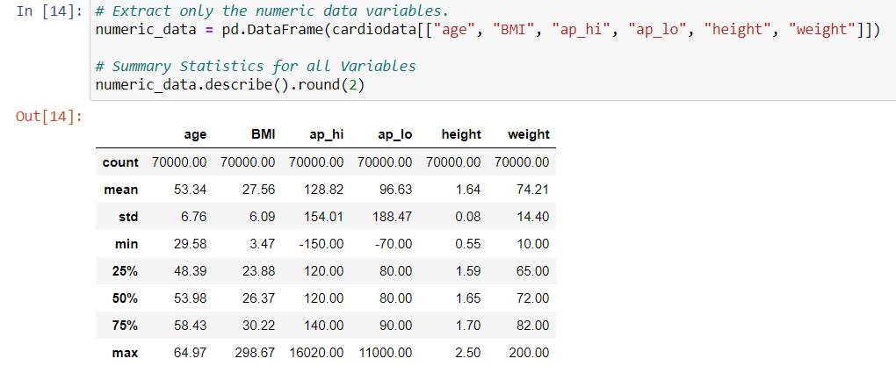
Statistical Summary of Dataset
Notes:
Further narrow down var.
BMI weight/hgt2 against BP and age
BP no effect. Hence irrelevant.

Slide 14
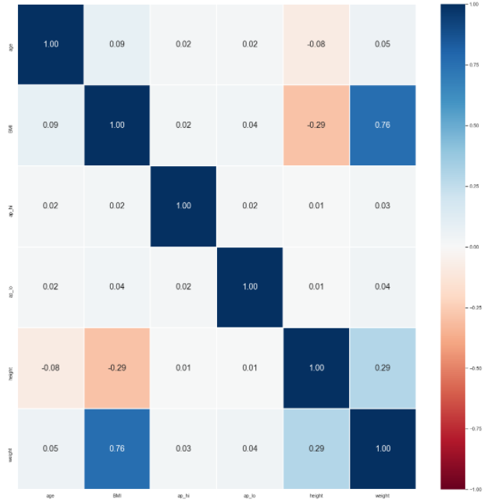
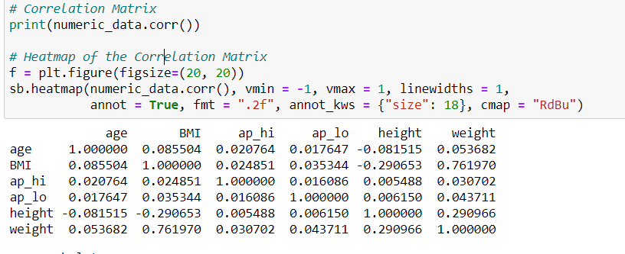
Heat Correlation Matrix
Notes:
Take out APHI APLO, focus on phy attribute and lifestyle habits

Slide 15
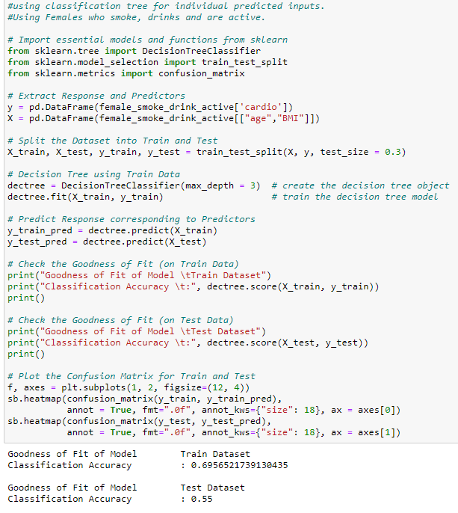
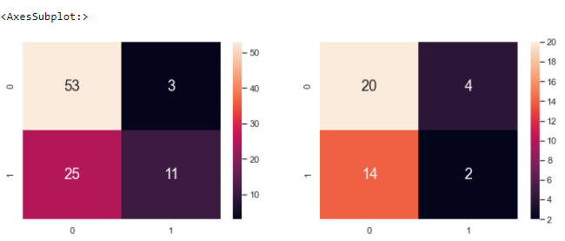
Goodness of Fit of Model
Female who smoke, drink, and active
Notes:
Split into 16 datasets, train and test 0.69 and 0.55 BASED ON DATASET.
Leave to WM to explain machine learning.

Slide 16

Machine Learning
Notes:
Thanks my guy. So the reason why we used classification tree is to predict users’ chance of developing cardiovascular diseases in terms of percentage. To accomplish this, we must first be able to work with both numeric and categorical datas provided to us in the cardio dataset. Classification tree, however, does not allow that and we can’t achieve that immediately using the codes we have practiced in practical work.

Slide 17
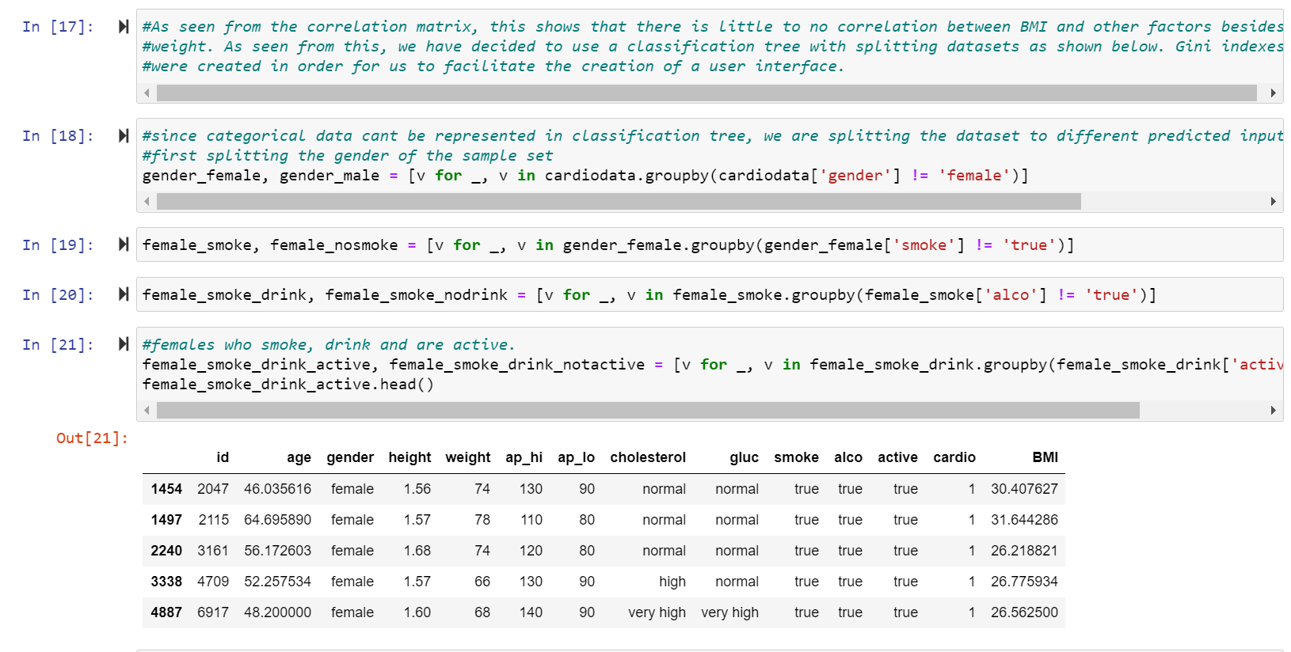
Splitting of Datasets
Notes:
So, to work around the fact that we are unable to work with both categorical and numerical values. We concluded 16 different datasets from the original cardio data. This is to match up with inputs that we predict the users will input for categorical data active, smoke, alcohol and gender. For example as seen in this slide, we have created a dataset sequence for females who smoke, drink and are active.

Slide 18
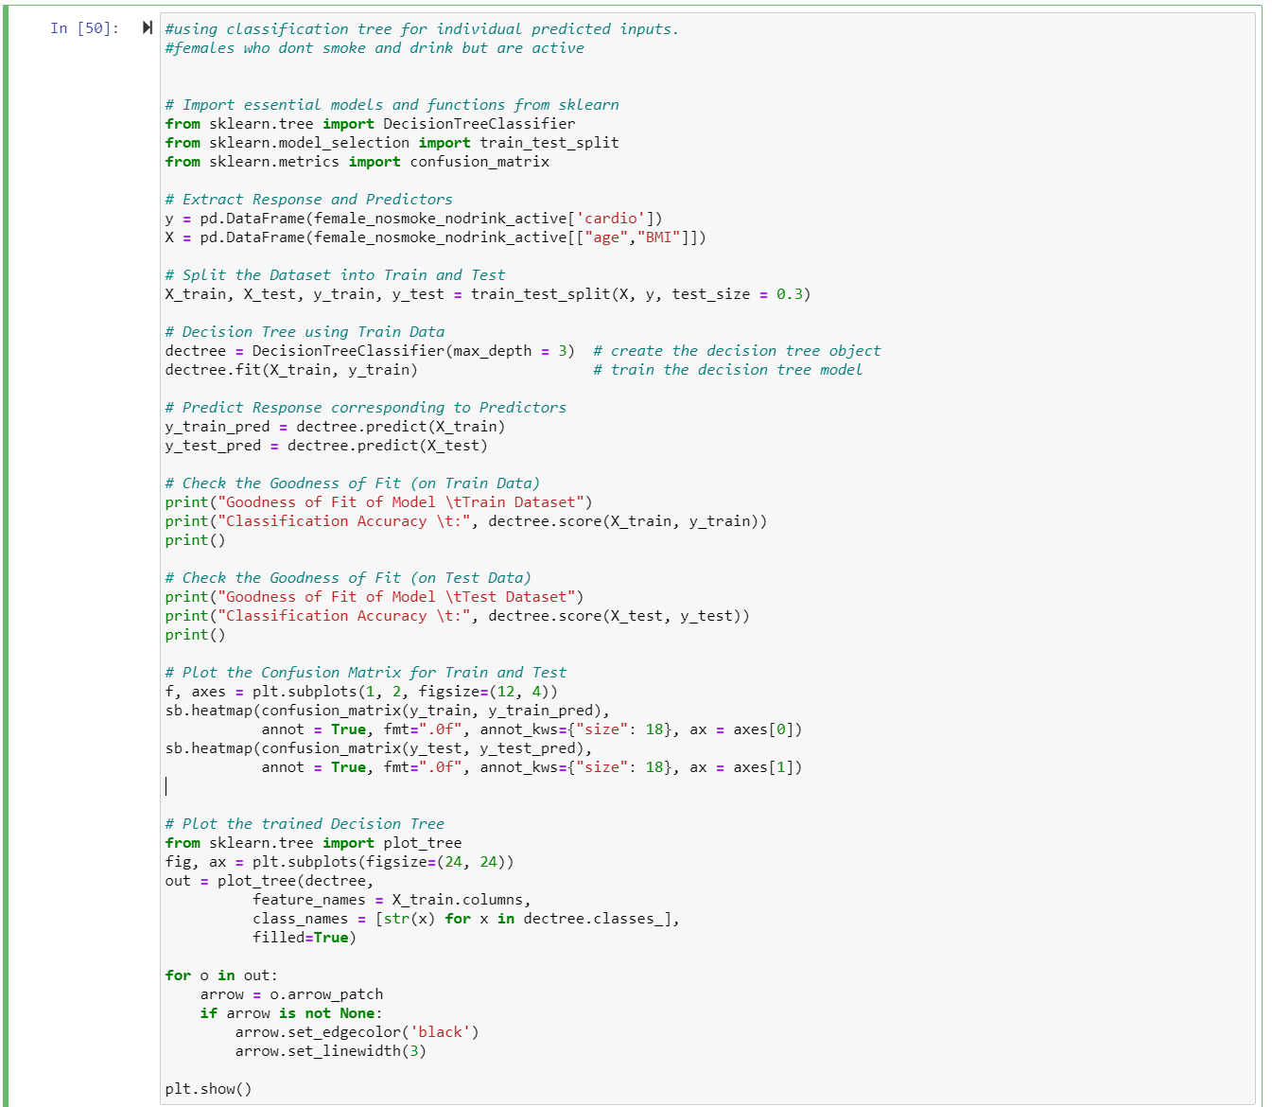
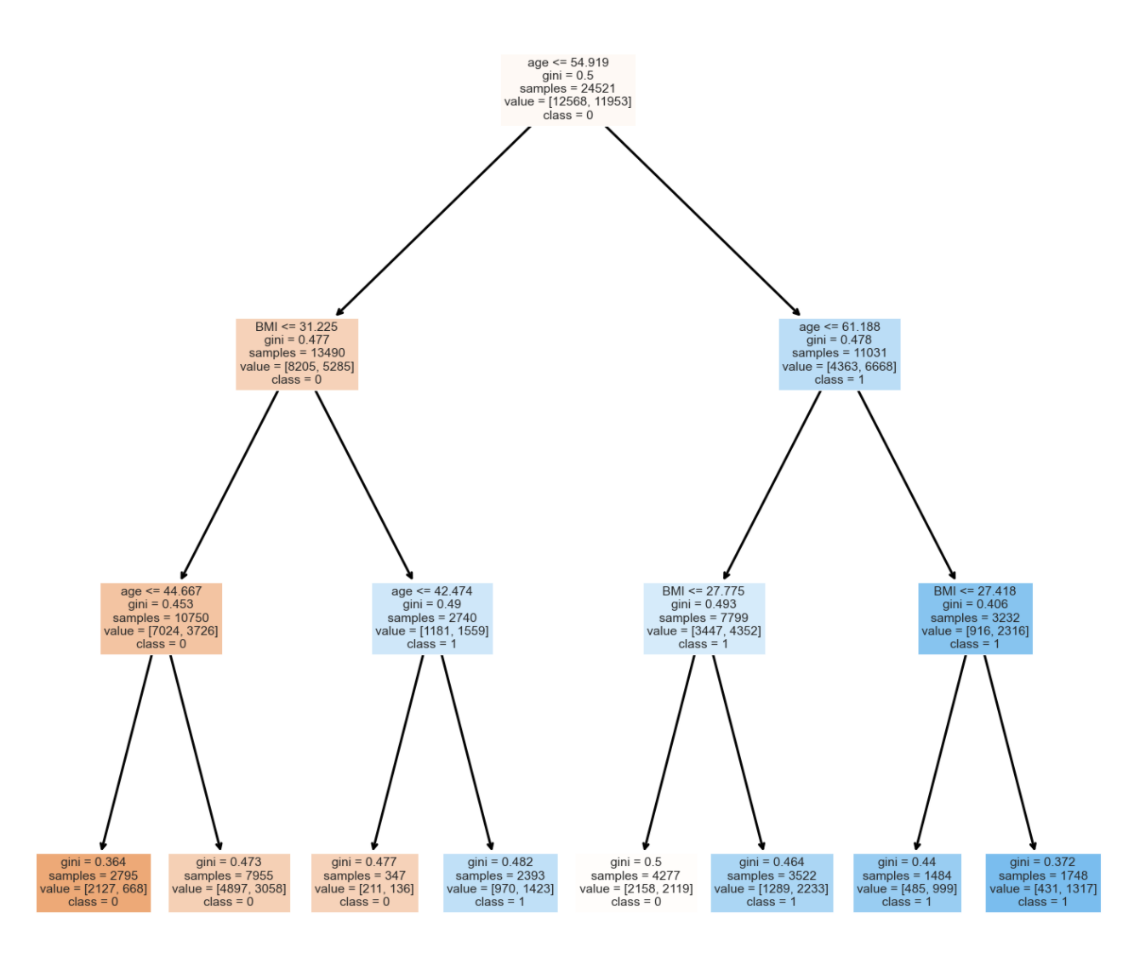
Classification Tree (Gini Index)
Notes:
Moving on to the prediction part, we used .3 and .7 of the individual datasets for test and train splits respectively. This way we move towards working our dataset against the numeric data BMI and age which generally are the easiest information that users will be able to input into our user interface. From majority of the findings we have concluded that the datasets are pretty much equal in terms of the variables we have put them against. As seen in this data we can infer that majority of the gini index ranges from 0.3 to 0.45 which are extremely close when predicting the chances of developing CVD. Moving on, germaine will be taking us through the user interface we have developed to calculate the risk of the user developing CVD.

Slide 19

User Interface (UI)

Slide 20
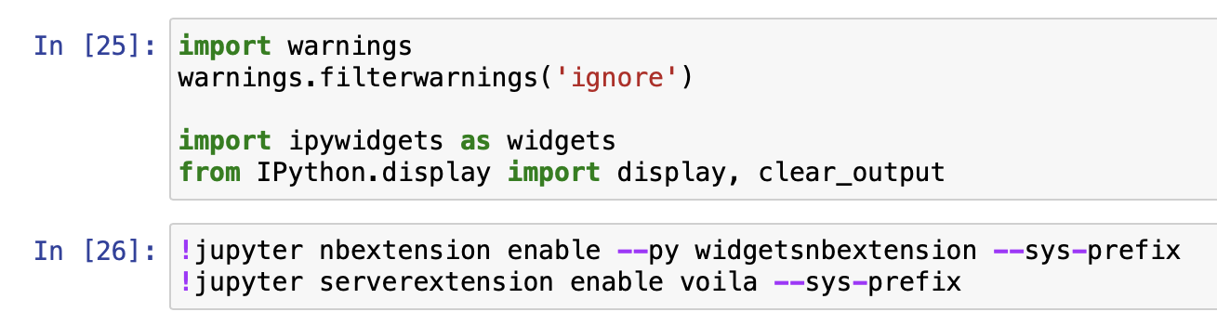
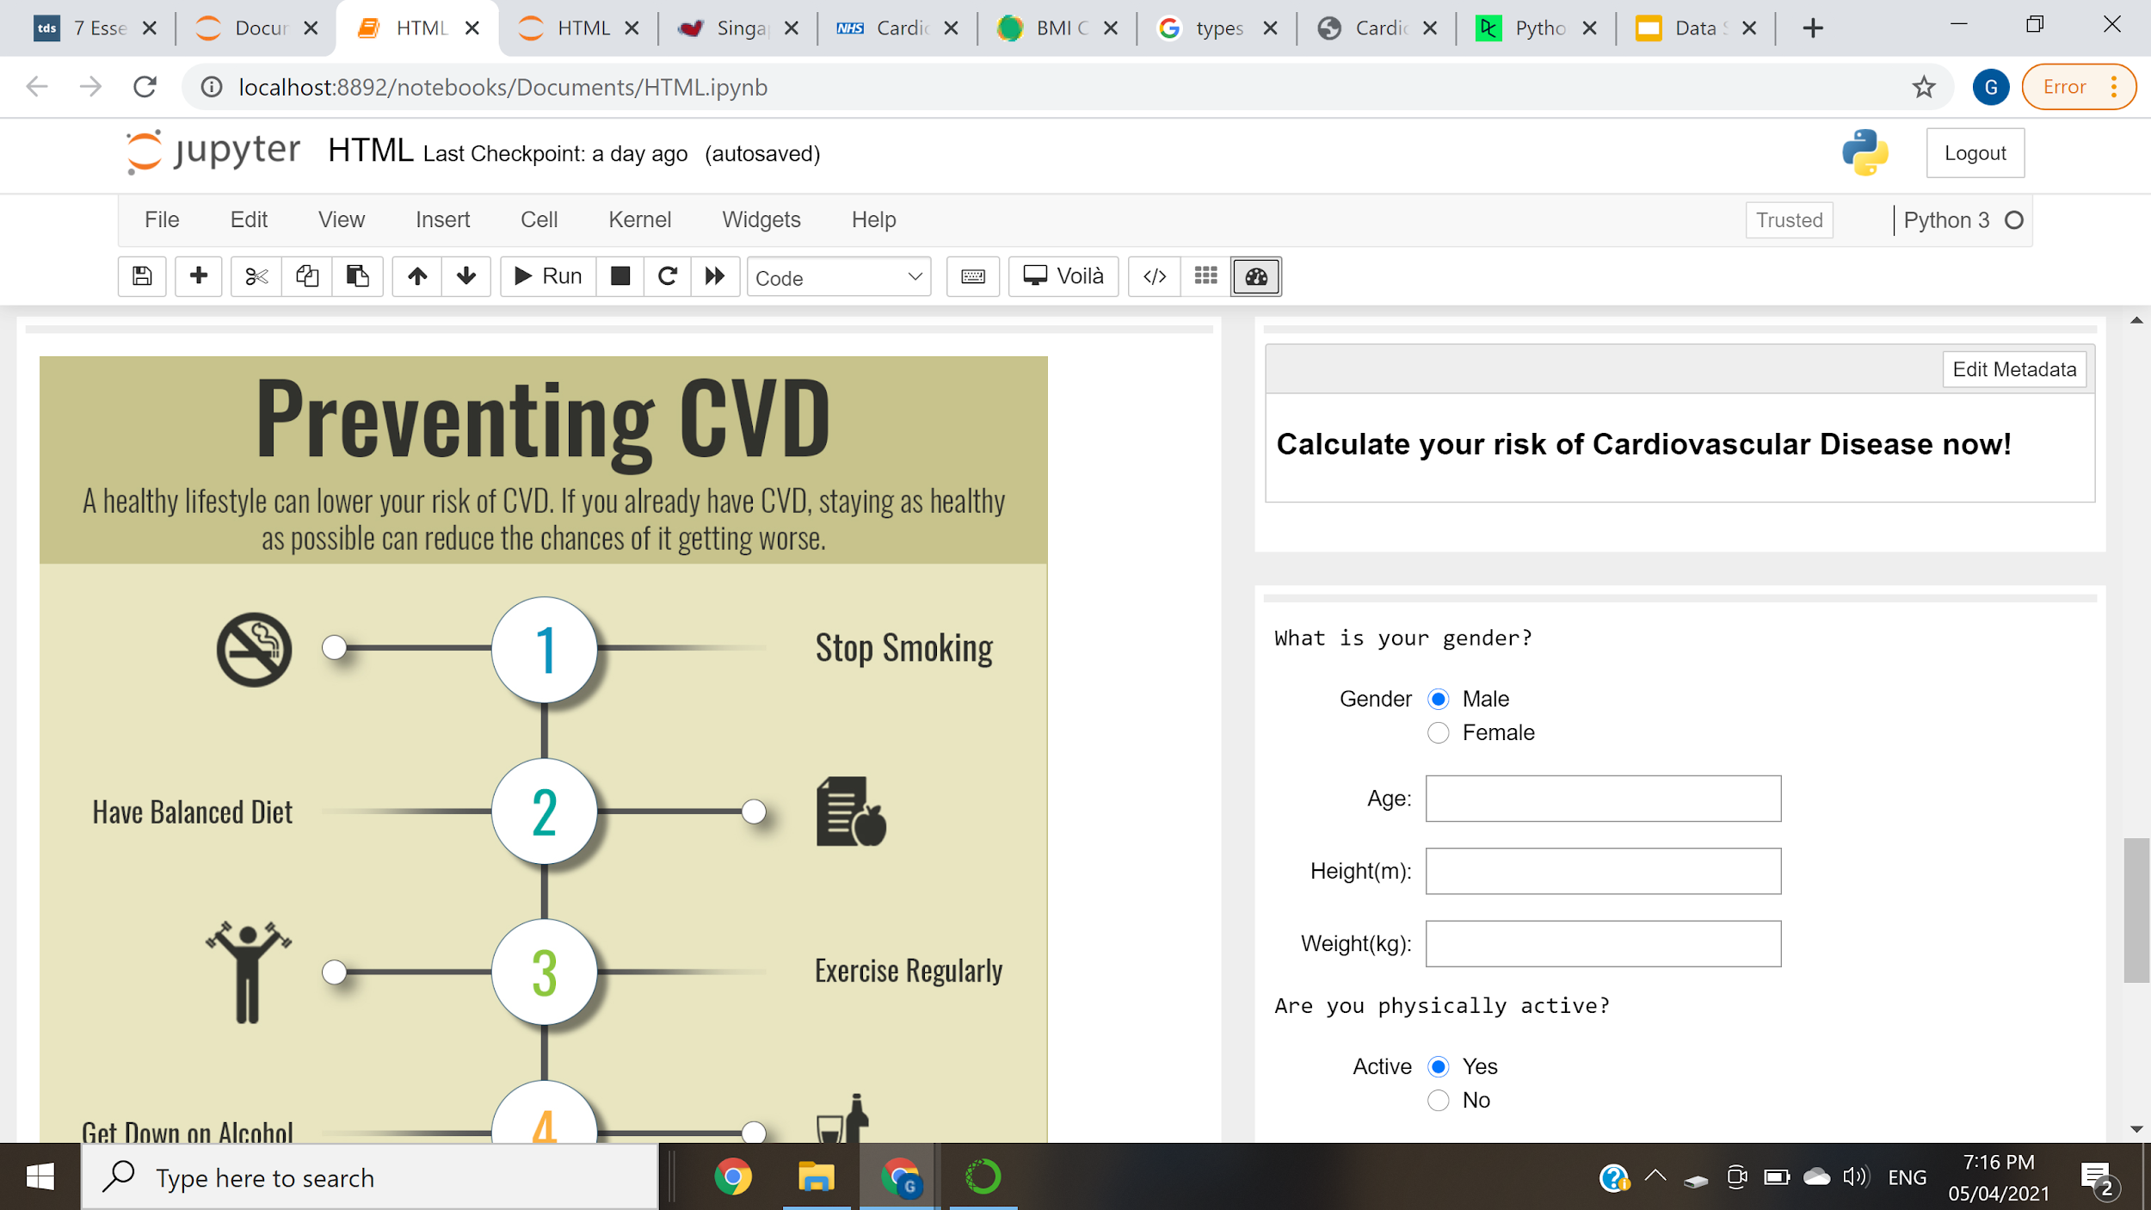
User Interface
ipywidgets
Interactive web page for the users
Such as, text box, radio and submit button
voila
A type of library
Used to render jupyter notebook into a standalone web application
Voila-gridstack
A dashboard
Make use of the cell metadata to layout the application
voila-gridstack
Notes:
we created an user interface as our main objective of this project is to spread awareness of cardiovascular disease. In this UI, users will be able to get information on cardiovascular disease and also calculate theIr risk of cardiovascular disease. This is done by using the following libraries in jupyter notebook.
Firstly, i imported ipywidgets for an interactive web application. Such as text box, radio and submit buttons
Secondly, i installed volia which is a type of library to render jupyter notebook into a standalone web app.
Lastly, the voila gridstack is a dashboard that make use of the cell meta data to layout the application.

Slide 21
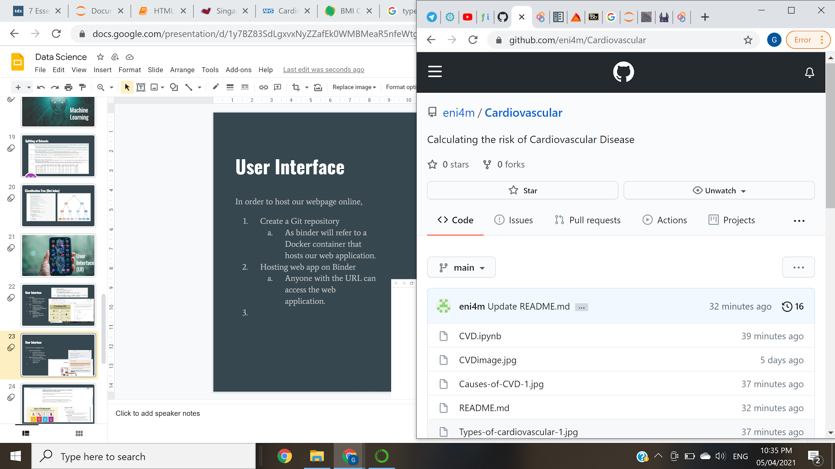
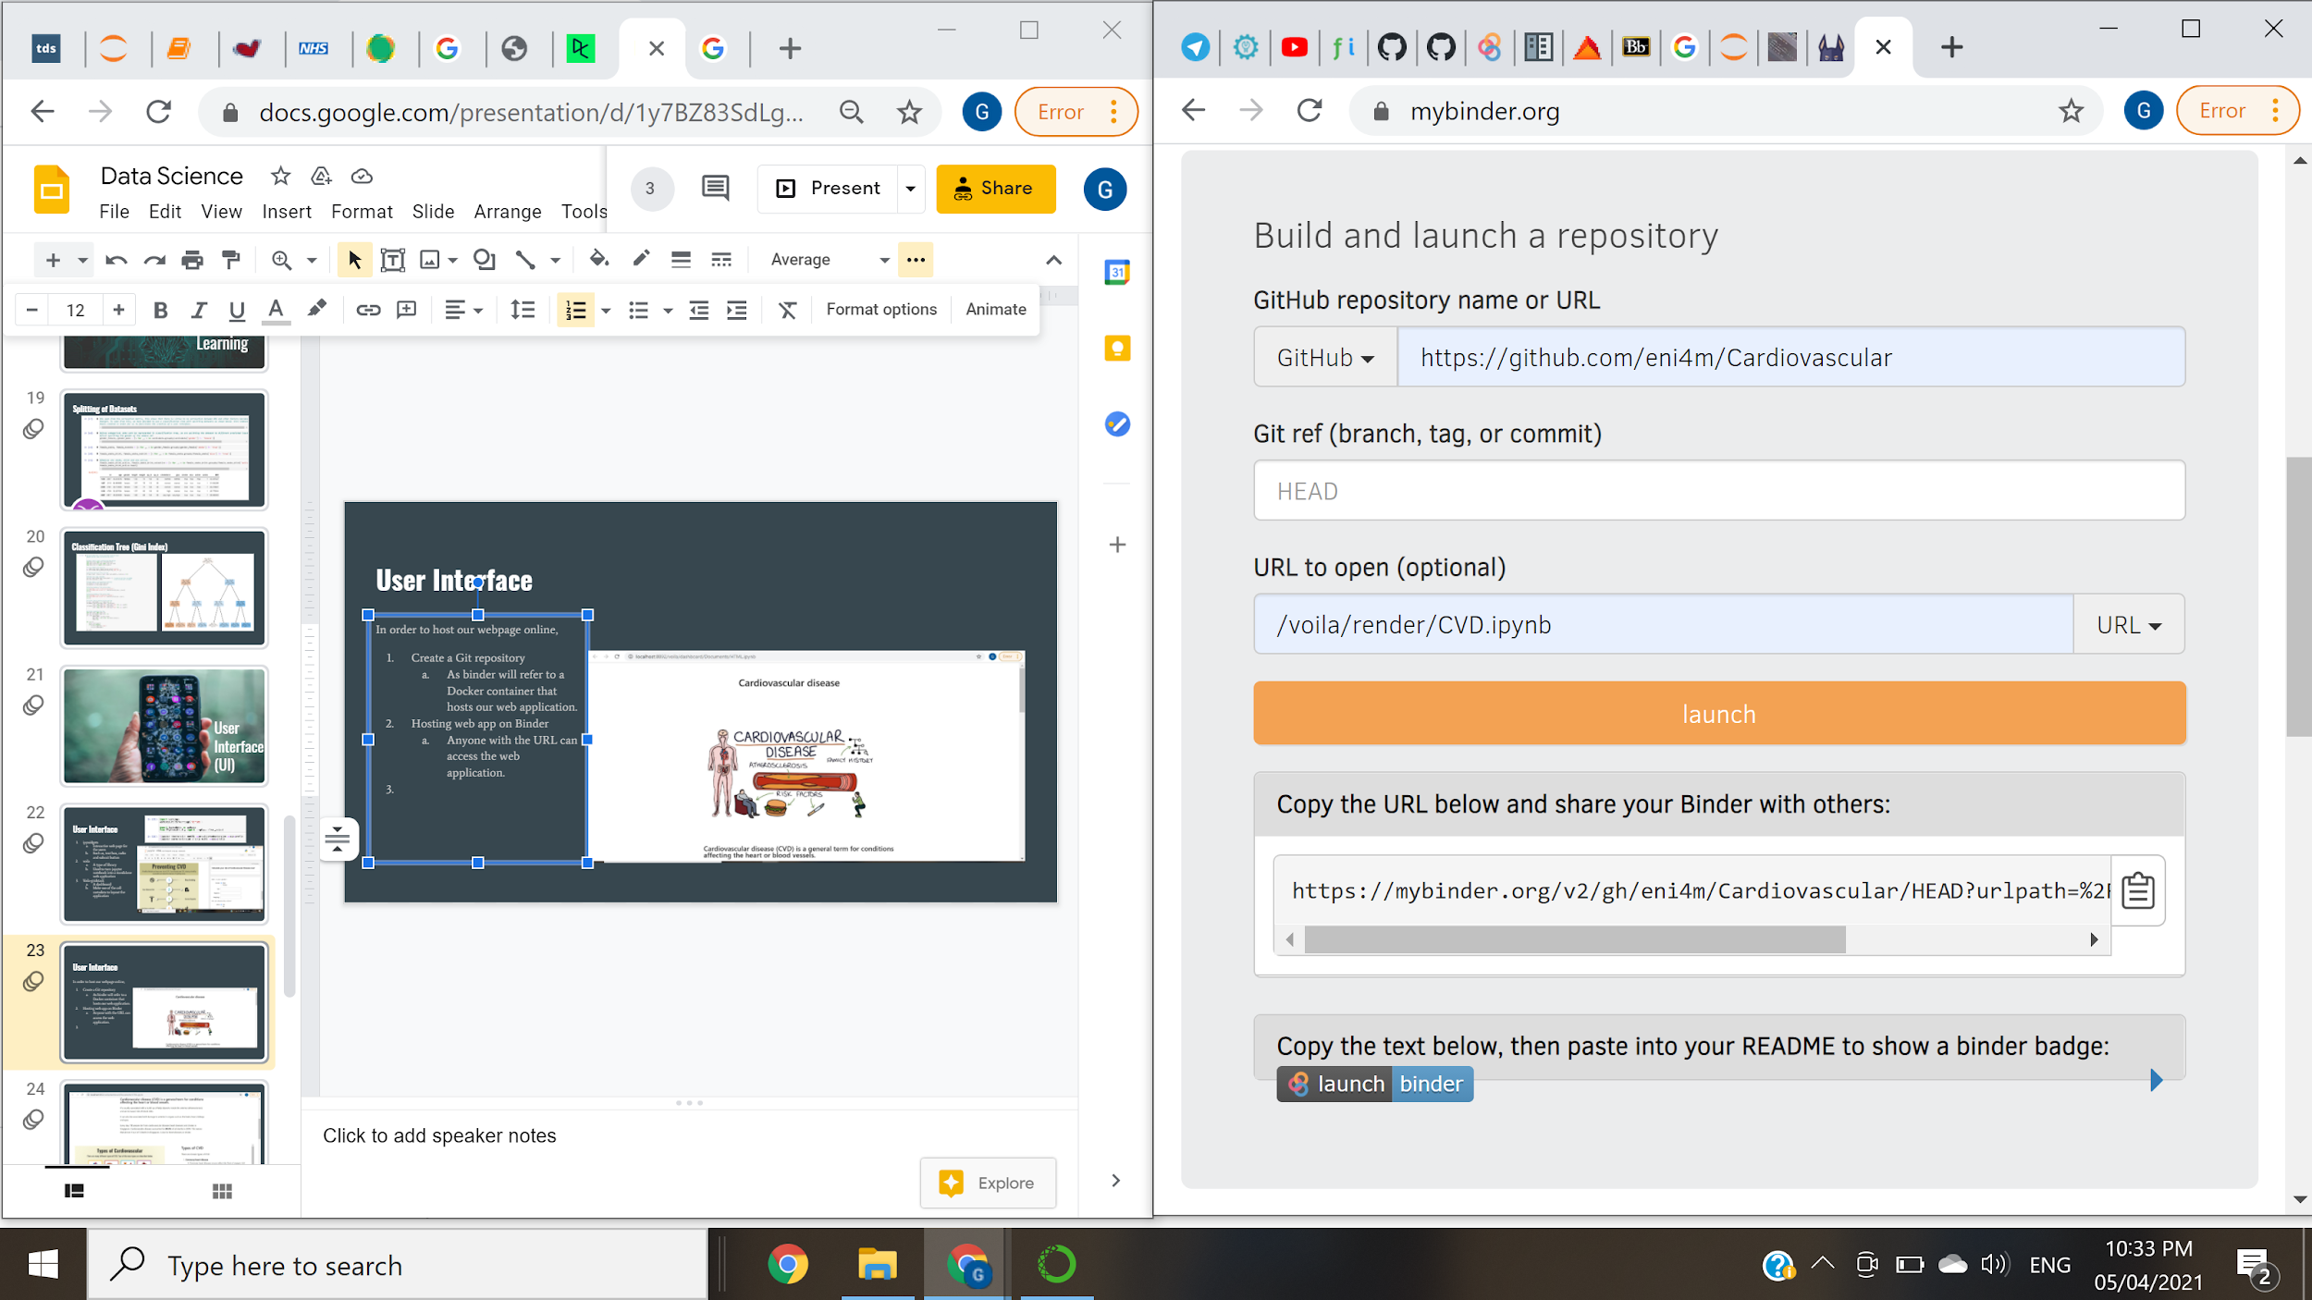
User Interface
In order to host our webpage online (QR code),
Create a Git repository
As binder will refer to a Docker container that hosts our web application.
Hosting web app on Binder
Anyone with the URL can access the web application.
Notes:
In order to host our webpage online, which is the QR code you guys scan before the start of our presentation. i create a git repo as binder will refer to a docker container that host the web app.
Next, i host the web app on mybinder.org so that anyone with the URL can access the web app.

Slide 22
Application Demo

Slide 23
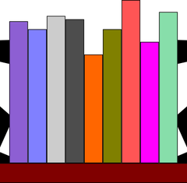
Outcomes & Interesting Findings
An increasing trend of Cardiovascular Disease (CVD) in Singapore
Smoking & drinking has a low risk of developing CVD
Weight has the highest impact on getting CVD
Notes:
Firstly, from our statistical research, there has been an increase of death due to CVD as mentioned by sebestian. From our datasets, we have noticed a lower risk of developing CVD when you either smoke or drink or both. And having weight as the highest impact on CVD. There are unlikely results as smoking and drinking both potentially increases your blood pressure and result in CVD. And we can’t depend on just weight to calculate the risk. Therefore, we included BMI which offers the usage of both height and weight.

Slide 24

Conclusion
Notes:
In conclusion, the dataset given to us to work with does not apply with many real life scenarios as we are unable to accurately determine a percentage for users’ inputs. Many of our findings results in around 40 to 50% chance of developing CVD even with the categorical and numeric datas we used to predict the users’ risk. Therefore, we are confident we will be able to recreate a similar project with a more realistic dataset that offers much more accurate data. Thank you for the time.

Slide 25
References
[1] M. Boyd, “How To Clean Up Data in a CSV File,” Business Envato Tuts+, 11-Jun-2013. [Online]. Available: https://business.tutsplus.com/articles/how-to-clean-up-data-in-a-csv-file--fsw-39773. [Accessed: 31-Mar-2021].
[2] S. Meshram, “Kaggle 5 day data cleaning challenge for beginners: Day 1- Handling Missing Values,” Medium, 27-Mar-2018. [Online]. Available: https://medium.com/@smeshram258/kaggle-5-day-data-cleaning-challenge-for-beginners-day-1-handling-missing-values-ee48b01e69cb. [Accessed: 04-Apr-2021].
[3] Ng Hwei, “How to Create an Interactive Web Application using a juypter notebook” finxter, 25-feb-2021. [Online]. Available: https://blog.finxter.com/how-to-create-an-interactive-web-application-using-jupyter-notebook/
[4] Rasmi Mishra, “Cardiovascular Disease - Types, Cause and Prevention…” AllizHealth, 2-May-2018. [Online] Available: https://blogs.allizhealth.com/cardiovascular-disease/

